Slide 1
Frontline Management of B-cell ALL
Nicholas Short MD
Associate Professor, Department of Leukemia
The University of Texas MD Anderson Cancer Center
March 2, 2024
SC-GL-AMG103-00108
Notes:
Thank you. First I want to thank ASH and the members of the Program Committee for the opportunity to present here today.
Today I’ll be presenting results of a phase II trial of the combination of mini-hyper-CVD and inotuzumab ozogamicin, with or without blinatumomab, for older patients with newly diagnosed Philadelphia chromosome-negative ALL

Slide 2
Disclosures
None

Slide 3
DISCLAIMER
The following presentation contains information about a product(s) or indication(s) that may not hold a marketing authorization in your country of residence.
Kindly check with your current Amgen representative on product(s) approval status in your country of residence.
Amgen does not recommend the use of its product(s) outside of the approved indication(s).

Slide 4
Treatment of Ph+ ALL: General Principles
BCR::ABL1 TKI added to chemotherapy improves survival
TKI options
First-generation (imatinib)
Second-generation (dasatinib or nilotinib)
Third-generation (ponatinib)
Increased molecular response rates and survival with successive generation of TKIs
? Role of intensive chemotherapy vs. low-intensity vs. chemotherapy-free regimens
? Role of HSCT in first remission with later-generation TKIs

Slide 5
GIMEMA LAL2116 D-ALBA Trial: Dasatinib + Blinatumomab for Ph+ ALL
63 pts with newly diagnosed Ph+ ALL (median: 54 years)
CNS prophylaxis
Steroid pre-treatment
Dasatinib + steroids
Response evaluation (d +85)
CHR + CMR
CHR but NO CMR
No CHR
Blinatumomab 28 μg for 2 cycles (maximum 5 cycles) + Dasatinib
Primary Endpoint
CMR evaluation after 2 cycles
Foa R et al. N Engl J Med 2020;383(17):1613-23

Slide 6
GIMEMA LAL2116 D-ALBA Trial: Dasatinib + Blinatumomab
63 pts with newly diagnosed Ph+ ALL (median: 54 years)
Molecular response rates:
End of day +85: 29%
After completion of blinatumomab: 75%
9 relapses (4 hematologic; 4 CNS; 1 nodal)
IKZF1^{plus} in 4/8 relapses (50%)
T315I mutations in 6/8 relapses (75%)
No difference between p190 and p210
HSCT in first remission in 24 pts (38%)
Foa R et al. N Engl J Med 2020;383(17):1613-23

Slide 7
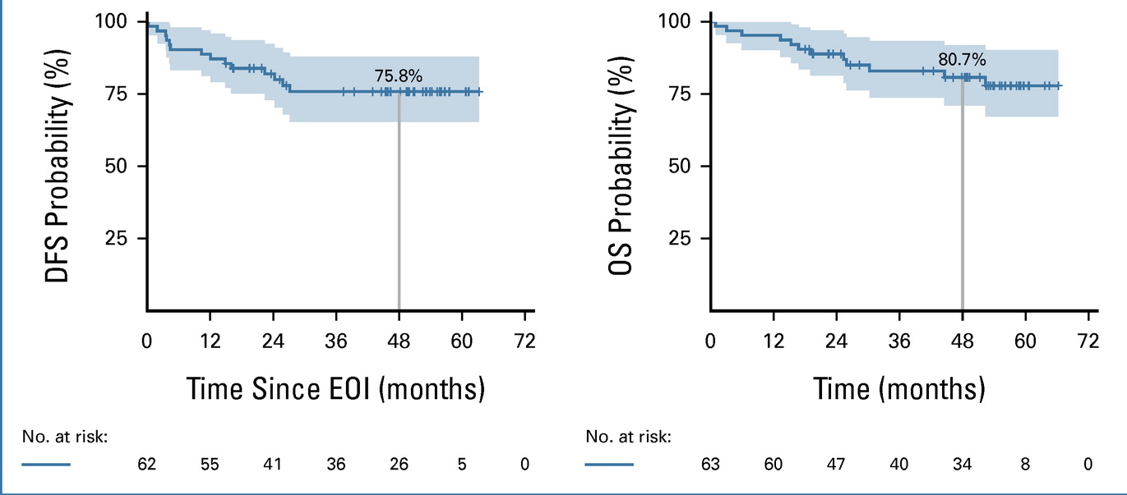
GIMEMA LAL2116 D-ALBA Trial: Dasatinib + Blinatumomab
Worse outcomes for IKZF1^{plus} genotype (DFS 46% vs. 82% without IKZF1del)
Foa R et al. J Clin Oncol 2023 (in press)

Slide 8
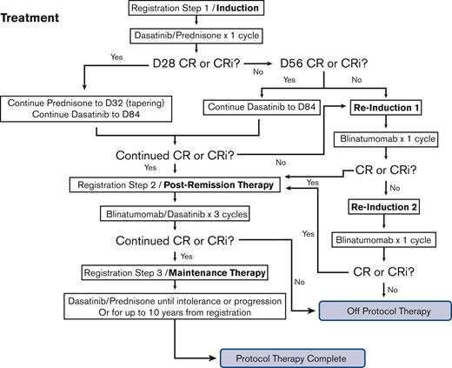
Dasatinib + Blinatumomab in Older Patients (≥65 Years of Age) with Newly Diagnosed Ph+ ALL
Advani A et al. Blood Adv 2023;7(7):1279-85

Slide 9
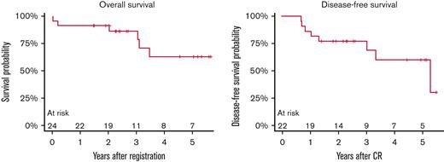
Dasatinib + Blinatumomab in Older Patients (≥65 Years of Age) with Newly Diagnosed Ph+ ALL
24 pts with newly diagnosed Ph+ ALL (median: 73 years)
CR with dasatinib + prednisone in 92%
CMR achieved in 12 pts (50%) + MMR in 5 pts (21%)
7 relapses (3 with T315I mutation)
3-year OS: 87%
3-year DFS: 77%
Advani A et al. Blood Adv 2023;7(7):1279-85

Slide 10
Ponatinib + Blinatumomab in Ph+ ALL: Regimen
Induction phase
Consolidation phase (C2-C5)
30 mg
15 mg (if in CMR)
4 weeks
2 weeks
Maintenance phase
15 mg for at least 5 years
Ponatinib 30 mg
Ponatinib 15 mg
Blinatumomab
IT MTX / Ara-C x 15
Short NJ et al. EHA 2023 (abstract S118)
Notes:
This is a visual schematic of the ponatinib plus blinatumomab study design.
Patients receive an induction cycle of ponatinib 30mg daily along with standard-dose blinatumomab on a 4-week on/2-week off schedule. Patients then receive up to 4 consolidations cycles of this regimen, followed by maintenance ponatinib for 5 years. Notably, the ponatinib dose is decreased to 15mg daily once patients achieve CMR.
All patients receive 12 doses of intrathecal chemotherapy.

Slide 11
Ponatinib + Blinatumomab in Ph+ ALL: Response Rates
Response, n/N (%) | Frontline Ph+ ALL N = 60
CR/CRi* CR CRi | 37/38 (97) 36/38 (95) 1/38 (3)
Early death | 1/38 (3)
MMR** | 50/52 (96)
CMR** After 1 cycle | 45/54 (83) 36/54 (67)
NGS MRD negative After 1 cycle | 41/46 (89) 9/20 (45)
* 22 pts were in CR at the start of therapy
** 8 pts were in MMR and 6 patients were in CMR at the start of therapy
Short NJ et al. EHA 2023 (abstract S118)
Notes:
This table shows the responses observed.
The overall CR/CRi rate among evaluable patients was 97%. Of note, there was one early death.
Among evaluable patients, 83% achieved a complete molecular response, and 67% achieved complete molecular response after 1 cycle of therapy.
89% of patients were MRD negative by the Clonoseq next-generation sequencing MRD assay (CLICK)
Interestingly, 4 of 5 tested patients who did not achieve CMR were NGS MRD negative, suggesting the BCR::ABL1 was not true MRD and was coming from the non-lymphoblast compartment.

Slide 12
Ponatinib + Blinatumomab in Ph+ ALL:
Survival Outcomes
Median follow-up: 16 months (range, 1-58+)
Event-Free Survival
Overall Survival
Only 1 patient transplanted to date
Short NJ et al. EHA 2023 (abstract S118)
Notes:
The median follow-up is 16 months.
The estimated 2-year event-free survival is 79%. The 7 events include 1 early death, 2 deaths in remission and 4 relapses. The estimated 2-year overall survival is 88%. One death was due to relapsed disease.

Slide 13
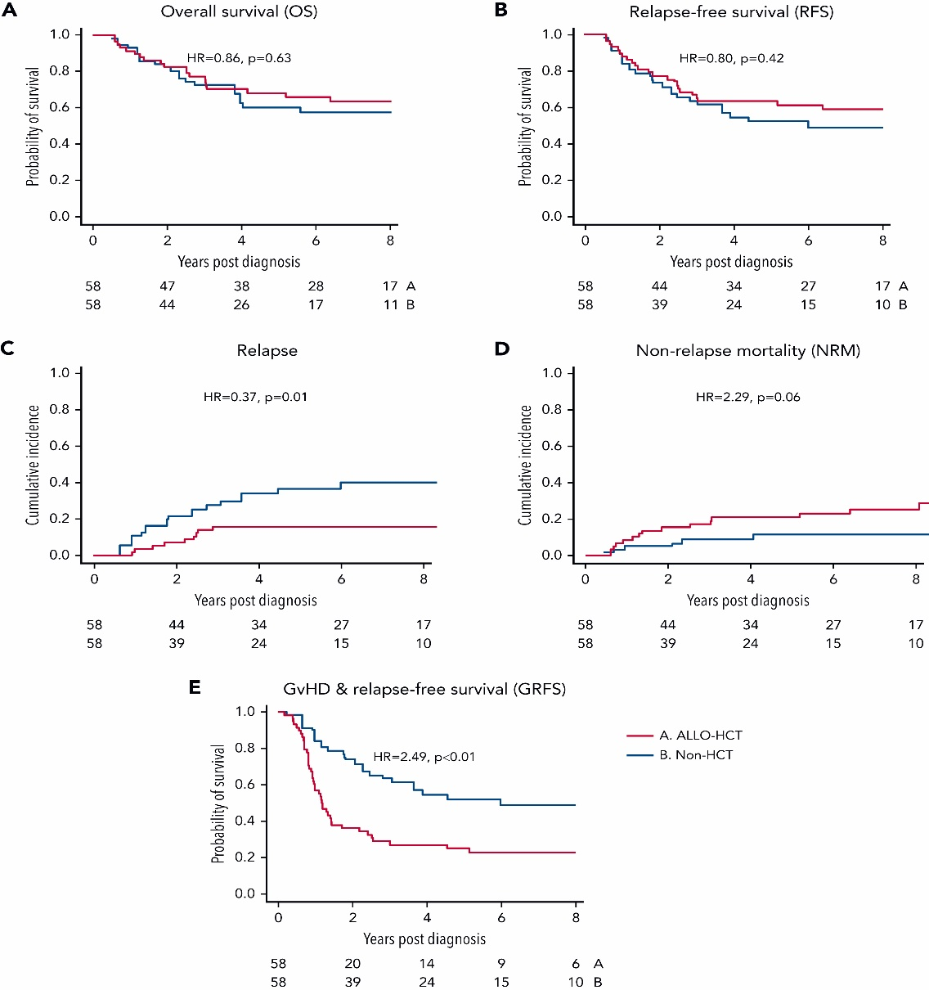
No Benefit of Allogeneic SCT in Patients with Ph+ ALL who Achieve CMR
Propensity score analysis of patients who achieved CMR within 3 months
Allogeneic SCT → lower risk of relapse but higher NRM
No impact of SCT on OS or RFS
Ghobadi A et al. Blood 2022;140(20):2101-12
Notes:
Including TKI

Slide 14
Outcomes of ALL in Older Adults
Outcomes with intensive chemotherapy
UKALLXII/ECOG 2993 – 5-year OS rate: 21%
MDACC – 5-year OS rate: 20%
Population-based data
SEER data (≥ 60 years) – median OS: 4 months; 3-year OS rate: 12.8%
Medicare data (≥ 66 years) – majority of patients did not receive any therapy
No clear standard of care in this population
Sive JI et al. Br J Haematol 2012; 157(4):463-71
O’Brien S et al. Cancer 2008; 113(8):2097-101
Geyer MB et al. Blood 2017;129(13):1878-81
Li S et al. Blood 2016;128(22):3981

Slide 15
Mini-HCVD + INO ± Blina in Older ALL: Modified Design (Pts #50+)
Intensive phase
Mini-HCVD
Blinatumomab
Mini-MTX-cytarabine
1
2
3
4
POMP
IT MTX, Ara-C
INO* | Total dose (mg/m²) | Dose per day (mg/m²)
C1 | 0.9 | 0.6 D2, 0.3 D8
C2-4 | 0.6 | 0.3 D2 and D8
Consolidation phase
5
6
7
8
Total INO dose = 2.7 mg/m²
Maintenance phase
*Ursodiol 300mg tid for
VOD prophylaxis
1-3
4
5-7
8
9-11
12
13-15
16
18 months
Jabbour E et al. Lancet Haematol 2023;10(6):e433-44
Notes:
This slide shows the most recent design of the trial, which incorporates both fractionated, lower doses of inotuzumab and addition of blinatumomab.
Beginning with patient 50, patients now receive 4 cycles of hyper-CVD plus inotuzumab, which is given in fractionated dosing on days 2 and 8. The total cumulative dose of inotuzumab is 2.7 mg/m2 with this modified design.
After 4 cycles of hyper-CVD, patients receive 4 cycles of blinatumomab consolidation at standard doses. Maintenance is with alternating blocks of 3 months of POMP and one cycle of blinatumomab for 16 total cycles.

Slide 16
Mini-HCVD + INO ± Blina in Older ALL: Response Rates
Response (N=74*) | N (%)
ORR | 73 (99)
CR | 66 (89)
CRp | 6 (8)
CRi | 1 (1)
No response | 1 (1)
Early death | 0
Flow MRD response | N (%)
Cycle 1, Day 21 | 61/72 (85)
Overall | 74/79 (94)
* 6 pts were enrolled in CR
Jabbour E et al. Lancet Haematol 2023;10(6):e433-44
Notes:
This table shows the responses observed.
The overall response rate was 98% with a complete remission rate of 88%. Only one patient did not respond to the regimen. Despite an older population with median age of 68 years, no early deaths were observed.
The MRD negativity rate at day 21 of the first cycle was 78%, and 96% of patients achieved MRD negativity at any point over the course of therapy.

Slide 17
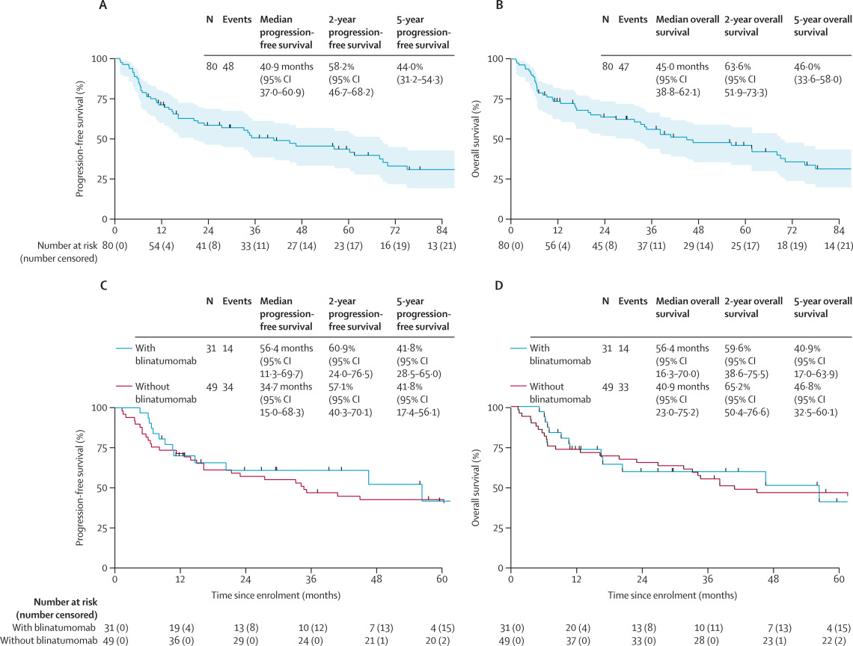
Mini-HCVD + INO ± Blina in Older ALL: PFS and OS (Entire Cohort)
Jabbour E et al. Lancet Haematol 2023;10(6):e433-44
Notes:
This figure shows the continuous complete remission duration and overall survival of the entire cohort of 70 patients.
The median CR duration has not been reached, with a 3-year continuous CR rate of 79%.
The median overall survival is 62 months, with a 3-year overall survival of 56%.

Slide 18
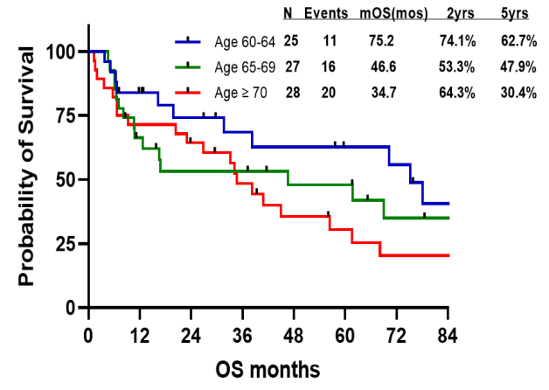
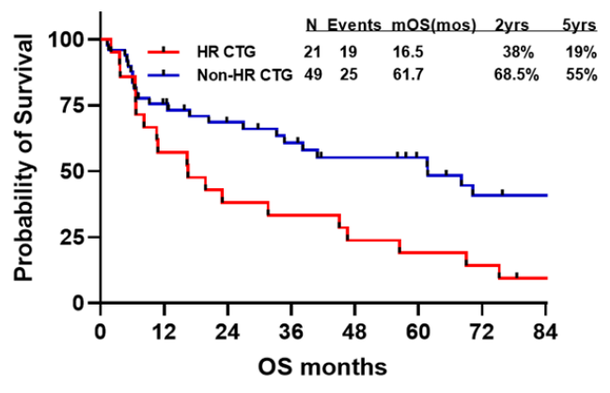
Mini-HCVD + INO ± Blina in Older ALL: Impact of Age and Cytogenetics (OS)
Jabbour E et al. Lancet Haematol 2023;10(6):e433-44

Slide 19
INO + Blinatumomab in Older ALL (Alliance A041703)
33 adults ≥60 years with newly diagnosed Ph-negative, CD22+ B-cell ALL
Regimen
Induction: INO 0.8/0.5/0.5 mg/m2 on days 1, 8 and 5 (cycle 1), then INO 0.5 mg/m2 on days 1, 8 and 15 (cycle 2)
Consolidation: Blinatumomab (standard doses) x 4-5 cycles
CNS prophylaxis with IT MTX x 8 doses
Wieduwilt MJ et al. EHA 2023 (abstract S117)

Slide 20
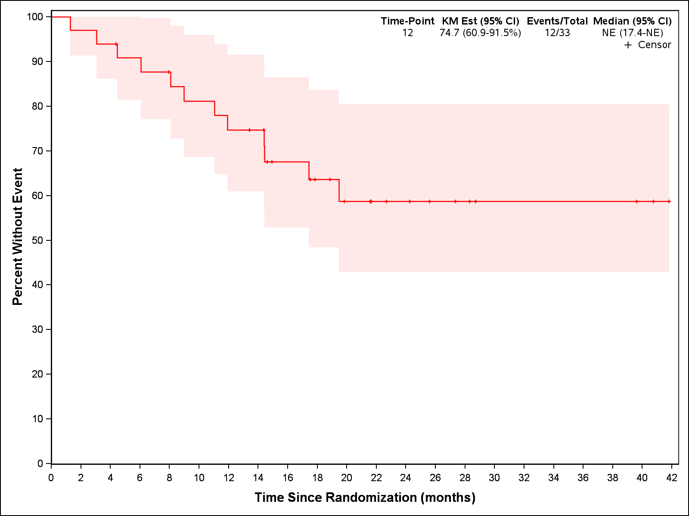
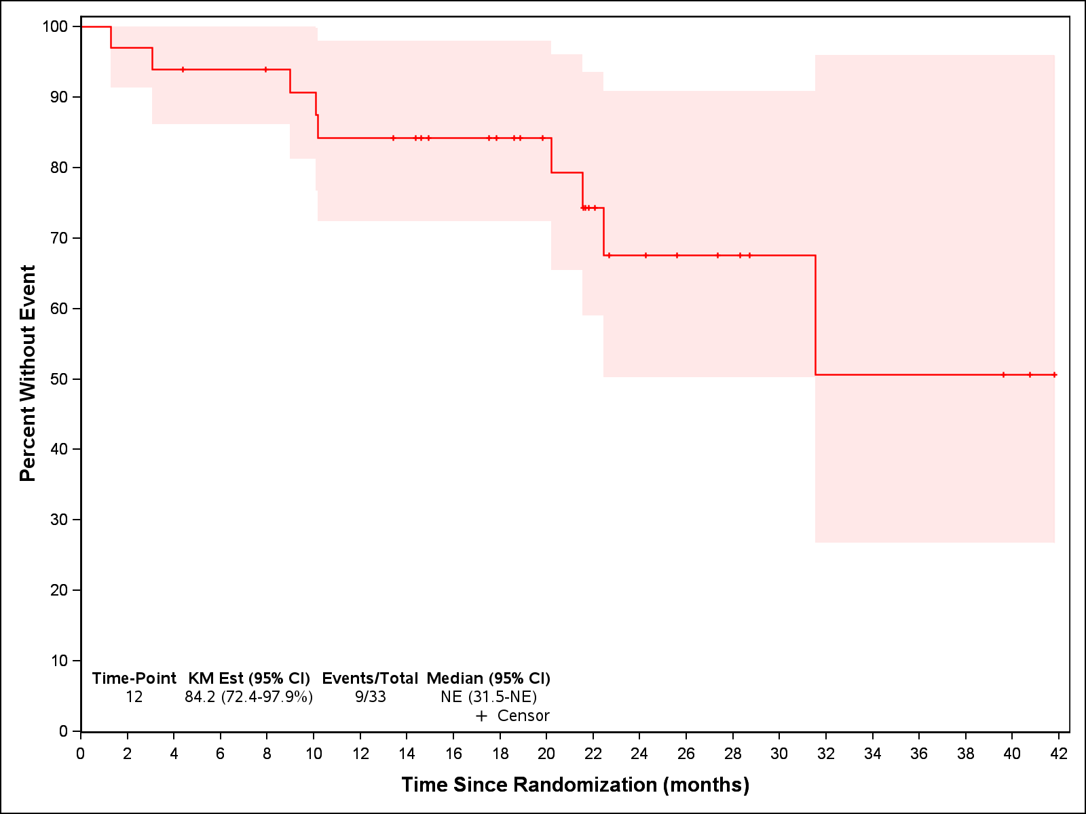
INO + Blinatumomab in Older ALL (Alliance A041703)
Overall response rate: 32/33 (96%) – 85% after INO
Events (n=12)
Relapse (n=9)
Death with refractory ALL (n=1)
Death in remission (n=2)
1-year EFS 75% (95% CI: 61-92%)
1-year OS 84% (95% CI: 72-98%)
Wieduwilt MJ et al. EHA 2023 (abstract S117)

Slide 21
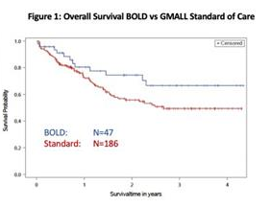
Low-Intensity Chemotherapy + Blinatumomab in Older Adults with B-cell ALL (GMALL BOLD)
Regimen: GMALL low-intensity chemotherapy protocol + up to 4 cycles of blinatumomab
Median age 66 years (range, 56-76 years)
CR/CRi rate after induction + blinatumomab: 76%
3-year OS rate: 67%
3-year OS: 81% for age 55-65 years; 53% for age >65 years
Outcomes appear superior to regimen without blinatumomab
Goekbuget N et al. ASH 2023 (abstract #964)
Notes:
This figure shows the overall survival for the 14 patients in the blinatumomab cohort, compared to the 46 patients who were treated with hyper-CVD + inotuzumab prior the latest amendment and who did not receive blinatumomab.
With a median follow-up of 13.2 months for the blinatumomab-treated patients, the 1-year overall survival rate is 91%. Notably, there have been 2 deaths in the blinatumomab cohort, one from VOD and one patient with complex cytogenetics and 2 TP53 mutations who relapsed during POMP maintenance and subsequently died from leukemia-related complications.

Slide 22
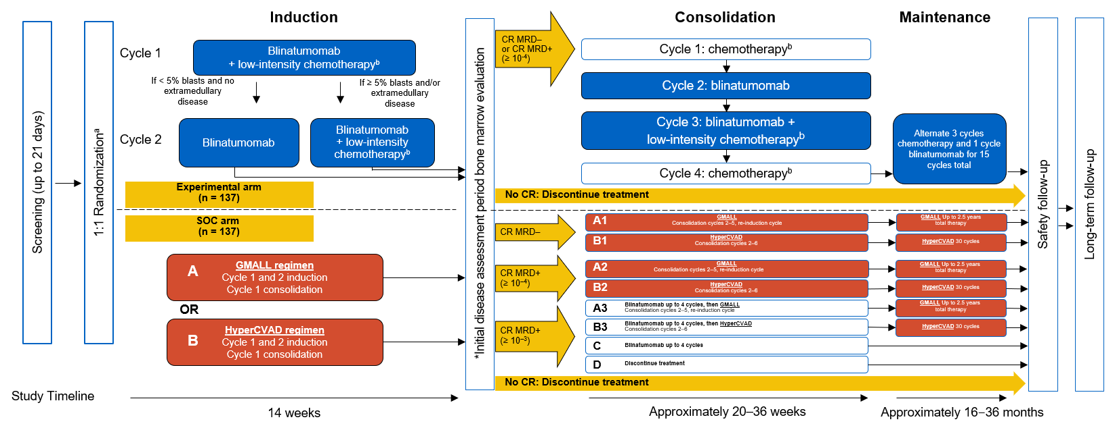
Golden Gate Study – Randomized Phase 3 Trial:
Frontline Blinatumomab Newly Diagnosed Ph- ALL (≥40 Years)
Co-primary endpoints: OS and EFS (including lack of MRD negativity at treatment failure)

